Slide 1
FUNCTIONAL DEPENDENCIES

Slide 2
Introduction
In a database management system (DBMS) system, functional Dependency in DBMS establishes the relationship between one attribute and another attribute. Functional dependencies make the quality of the data in the database easier.
The symbol for a functional dependency is an arrow. X->Y stands for the functional dependence of X on Y. Functional Dependency is a key factor in determining the quality of database architecture.
Determinant refers to the attribute set on the left side of the arrow, X. In contrast, Dependent refers to the attribute set on the right side, Y. While Y will be a dependent non-key attribute from a table that shares the main key with X, X will be the primary key attribute.

Slide 3
It demonstrates the functional dependence between the non-key attribute Y and the primary key attribute X.
Simply put if a table's column X characteristic uniquely identifies its column Y attribute. The functional dependence of column Y on column X is symbolized as X->Y.
Functional dependencies are a crucial part of understanding advanced Relational Database System principles since they mathematically represent relationships between database elements.

Slide 4

Example of Functional Dependency in DBMS
Let's see functional Dependency in DBMS with an example.
Assume that the student database has two distinct attributes: Stu Id and Stu Name.
The StuId serves as our main key. And in this case, StuId uniquely identifies the StuName attribute. You must first have the StuId if someone wishes to know the student's name. if someone wishes to know the student's name.

Slide 5

The functional Dependency between Stu Id and Stu Name mentioned above can be expressed as Stu Id depends on Stu Name.

Slide 6
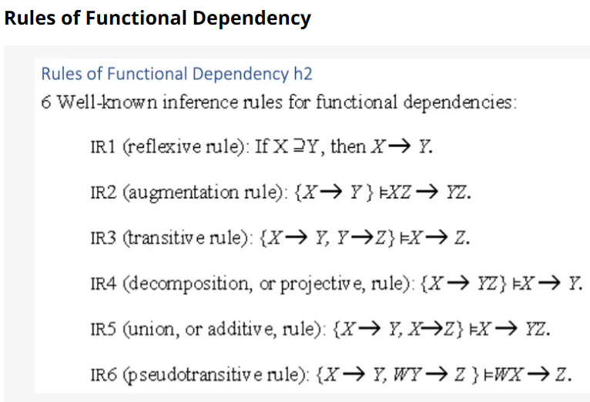

Slide 7
Reflexive Rule :
In the reflexive rule, if Y is a subset of X, then X determines Y.
If X ⊇ Y then X → Y
Example:
X = {a, b, c, d, e}
Y = {a, b, c}
2. Augmentation Rule (IR₂)
The augmentation is also called as a partial dependency. In augmentation, if X determines Y, then XZ determines YZ for any Z.
If X → Y then XZ → YZ
Example:
For R(ABCD), if A → B then AC → BC

Slide 8
3. Transitive Rule (IR₃)
In the transitive rule, if X determines Y and Y determine Z, then X must also determine Z.
If X → Y and Y → Z then X → Z
4. Union Rule (IR₄)
Union rule says, if X determines Y and X determines Z, then X must also determine Y and Z.
If X → Y and X → Z then X → YZ
Proof:
X → Y (given)
X → Z (given)
X → XY (using IR₂ on 1 by augmentation with X. Where XX = X)
XY → YZ (using IR₂ on 2 by augmentation with Y)
X → YZ (using IR₃ on 3 and 4)

Slide 9
5. Decomposition Rule (IR₅)
Decomposition rule is also known as project rule. It is the reverse of union rule.
This Rule says, if X determines Y and Z, then X determines Y and X determines Z separately.
If X → YZ then X → Y and X → Z
Proof:
X → YZ (given)
YZ → Y (using IR₁ Rule)
X → Y (using IR₃ on 1 and 2)

Slide 10
6. Pseudo transitive Rule (IR₆)
In Pseudo transitive Rule, if X determines Y and YZ determines W, then XZ determines W.
If X → Y and YZ → W then XZ → W
Proof:
X → Y (given)
WY → Z (given)
WX → WY (using IR₂ on 1 by augmenting with W)
WX → Z (using IR₃ on 3 and 2)

Slide 11
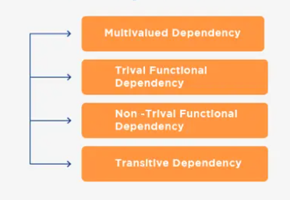
Types of Functional Dependencies in DBMS

Slide 12
1. Trivial Functional Dependency
A trivial functional dependency is a table or data set dependency that happens when the functional dependency of an attribute or set of attributes includes the original one.
The formula X→Y is a trivial functional dependency if Y is a subgroup of X.
For example, a data table with employee identification (ID) numbers and employee names often would reflect the employee ID number as a subset of the overall ID and name data. It would be written as:
{id, name}→id

Slide 13
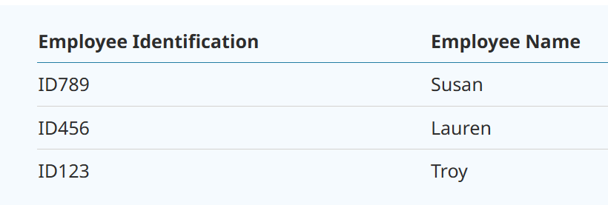

Slide 14
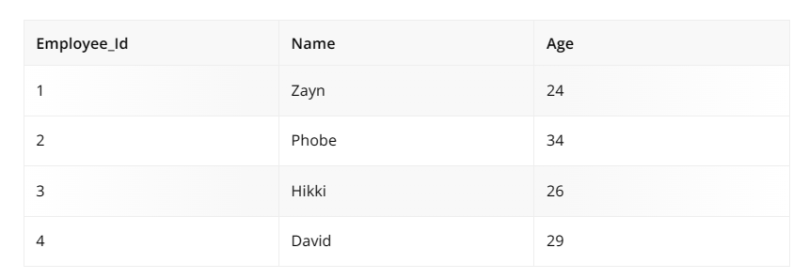
Given that the dependent Name is a subset of the determinant Employee Id, Name, the functional Dependency between
{Employee Id, Name} and {Name} in this case is trivial.
Additionally trivial are Name, Age, and Employee Id. The name is also trivial. Employee Id is trivial.

Slide 15
2. Non-Trivial Functional Dependency
The trivial functional Dependency in DBMS is opposed by it.
Formally speaking, dependent if not a subset of the determinant in Non-Trivial functional Dependency.
If Y is not a subset of X, the relationship between X and Y is said to be non-trivial functional.
A functional dependency X Y that is not trivial is one in which X is a collection of attributes, and Y is likewise a set of those attributes but not a subset of X.
Example:
Take a look at the Employee table, for instance.

Slide 16
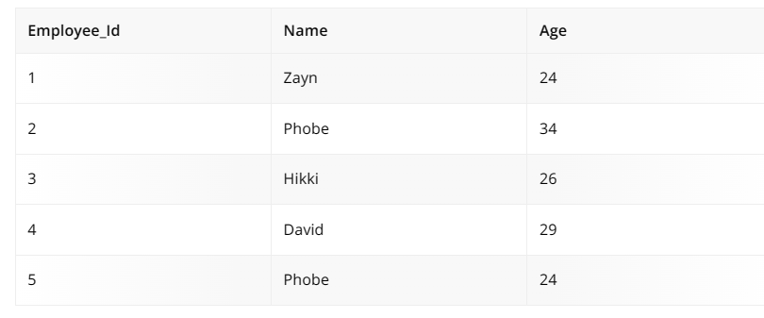
Because Name(dependent) is not a subset of Employee Id, there is a nontrivial functional dependency between Employee Id and Name in this situation.
The functional dependencies {Employee Id, Name} -> { Age } are likewise nontrivial.

Slide 17
3. Multi-valued functional Dependency
Multivalued dependency occurs when you have several independent, multivalued attributes in the same table.
It’s often a full constraint between two attribute sets in a table or relation.
For example, a model car manufacturer keeps track of car models, manufacturing year and paint colors.
The year and color are independent of each other, yet dependent on the car model. Those two attributes are multivalue dependent on the car models.
The dependencies would be written as:
model→year and model→color

Slide 18
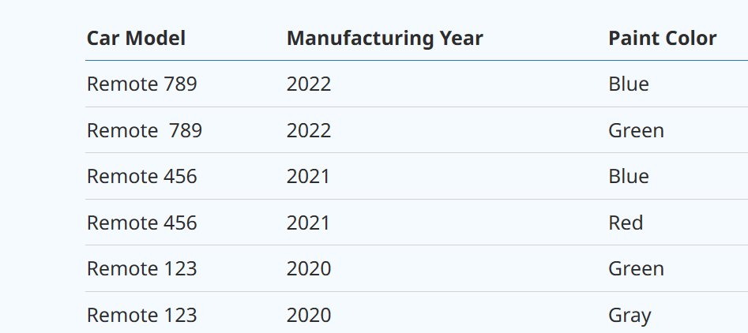

Slide 19

Since the dependent attributes Name and Age are not functionally dependent (i.e. Name->Age or Age->Name doesn't exist! ), {Employee_Id} -> {Name, Age} is a multivalued functional dependency in this case.

Slide 20
4. Transitive functional Dependency
Transitive dependency occurs when you have two functional dependencies that form a transitive one indirectly, most often because of software components and programming.
It only occurs when you have a relation of at least three attributes or more.
For example, if the employee ID depends on the name, which depends on location, then the ID becomes transitively dependent on the location.

Slide 21
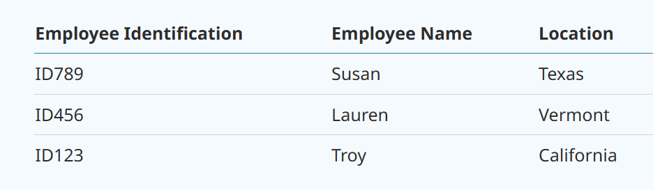
The dependencies would be written as:
ID→name and name→location
Therefore, ID→location should be true.

Slide 22
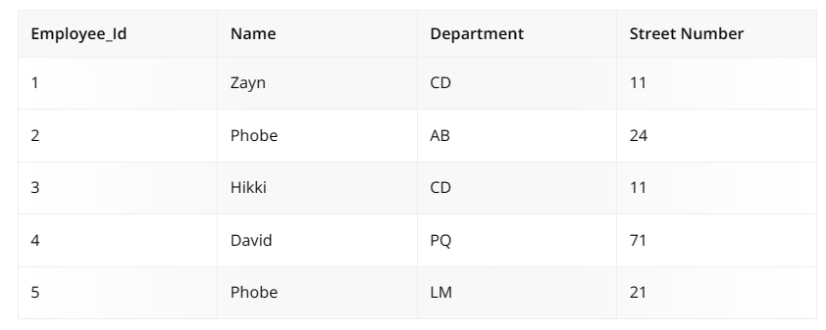
In this case, the relationships between Employee Id, Department, and Street Number are valid. Consequently, Employee Id and Street Number are both valid functional dependencies according to the axiom of transitivity.

Slide 23
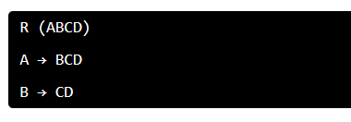

How to Denote a Functional Dependency
An "arrow" represents a functional dependency. A B symbolizes the functional dependence of A on B.
An example is a relation with the four attributes A, B, C, and D.
Attributes B, C, and D are functionally reliant on attribute A in the first functional dependence.

Slide 24
Function dependency B->CD two qualities, C and D depend on attribute B to function.
All elements on the left side of a functional dependency are sometimes referred to as the determinant set, and all of the elements on the right side are the dependant attributes.
Functional Dependency in DBMS, a diagrammatic representation of functional Dependency,
The dependent attribute is determined by pointing arrows, and the arrow's origin determines the determinant set.

Slide 25
Advantages of Functional Dependency
The advantages of functional dependency are many. Some of them are listed below:
The database's data quality is maintained using it.
It communicates the database design's facts.
It aids in precisely outlining the limitations and implications of databases.
It is useful to recognize poor designs.
Functional Dependency eliminates data duplication in cases where the same values shouldn't appear more than once in the same database table.
Finding the potential keys in the relationship is the first step in the normalization procedure. Identifying potential keys and normalizing the database without functional dependencies is impossible.

